Slide 1
Welcome to KeyVerticals Platform Demo Presentation
Performance Based Lead Gen. Engine

Slide 2
www.KeyVerticals.com
INTRODUCING
Top Lead Engine For Established Verticals
1
2
A Chance to Get an Edge on the Platform
3
Free Brand Exposure
Competitive Bid System for Quality Leads
4

Slide 3
www.KeyVerticals.com
In a Nutshell...
More & More of your Ideal Customers are gathering online.
Lets Help You Get them. You Pay Only on Leads Delivery...

Slide 4
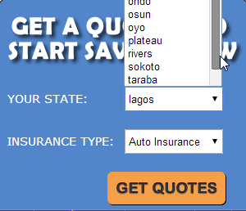
www.KeyVerticals.com
We Engage Customers Who Intend To Buy. How? We have a very simple process of “Intent Identification”:
Filling the above form is a clear declaration of Intent... What Follows, an even bigger one:

Slide 5
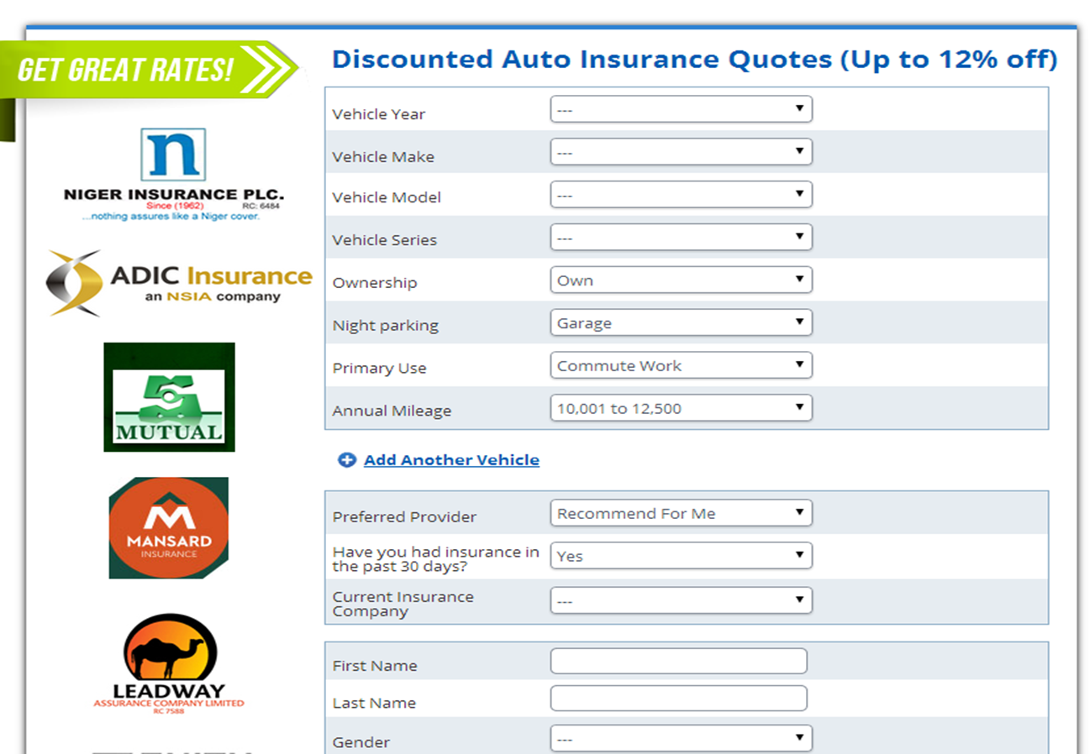
www.KeyVerticals.com

Slide 6
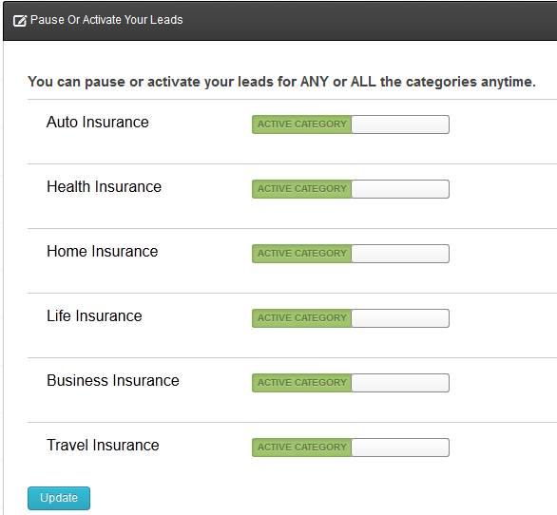
www.KeyVerticals.com
Separate the Consumers You Want, From Those You Don’t. You Get to target the exact Niches you want. This (for example) is perfect for those Insurance companies that don’t offer all Insurance Policies. If you want only Auto Insurance Policy Seekers, we will get them for you.

Slide 7
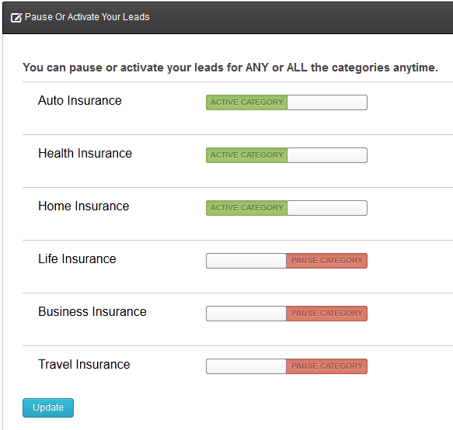
www.KeyVerticals.com
Pause or Activate any Vertical Anytime

Slide 8
www.KeyVerticals.com
Leads on the Platform are Extremely Targeted and Warm. We Guarantee That! How?
We Have the Most Optimized Process in Lead Generation Online. By scanning to make sure our Lead form all over the web is implemented only on approved webpages, and uniquely matching contact details with an algorithm for authenticity verification, you will only get leads that convert. Period!
Zero Tolerance for Lead Incentivization of any Kind...
The Results = Sales.

Slide 9
www.KeyVerticals.com
And We do this Through Different Types of Media. We are everywhere. Online!
We work with some of the most visited websites in insurance, payday loans, properties, education etc. Our publishers have the volume of traffic you need to get more customers.
When a targeted consumer uses a search engine to find a service in the marketplace, we’ll be sure your brand ranks high – through both organic and paid listings.
While your ideal consumer is stalking their ex on Facebook, we’re targeting them with your ads. Muahahaha. Okay, nothing Grey or Black hat.
Mobile-ready advertising means you can reach far more targeted number/customer base. Good thing is, we do this for you and deliver only Results! Nothing like this exists out there.

Slide 10
www.KeyVerticals.com
More on Authenticity Verification
Lead Data Authentication:
Form Intelligence: When a Lead Form is filled, the Form automatically processes the email entered to see if the email and other contact details entered is in the correct format for a valid email address or phone number. If it isn’t, the form is rejected automatically.
Advanced Data Verification: After a Successful lead submission, an email is automatically dispatched to the new registration. This email message will bounce if the email is invalid. Once a Bounce occurs, the Backend Algorithm automatically scans and analyzes the Bounce to determine the reason. If it’s established that the bounce occurred as a result of non-existence or non-active email address data, that lead is automatically rejected.

Slide 11
www.KeyVerticals.com
Some of Our More Popular Publishers are:
Authority High Traffic Sites With Comfortable Search Engine Rankings... e.g.,
http://InsuranceQuotes.ng/
http://AutoInsuranceArena.com/
http://iPayAdvance.com/
http://onlinedegreecentre.com/
Etc.
Established Media Buyers on the Google Ad Planner Platform e.g..,
Dayo Salawu, Co-Founder of Peerzux.com
Kolawole Bisiriyu, Self Styled Copywriting King
Key Verticals In-house Traffic & Conversion’s Team.
Etc.
.

Slide 12
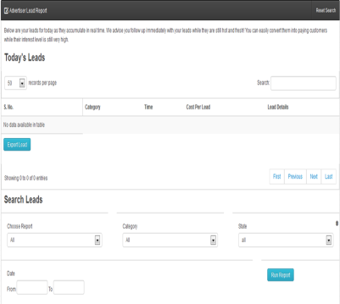
www.KeyVerticals.com
Getting & Delivering Results is as easy as 123, or the following Steps Below:
Our Publishers go to where the demand is: On Search Engines, Vehicle Registrations & Purchase Vendors Online Etc. and Engage digitally, your potential Customer.
Your Potential Customer then lands on the Publisher’s web portal and completes a short intent declaration form and tells the Engine the kind of Product she wants and in what part of the country she is.
Based on this short form, we provide a Matching form to help capture all necessary details needed to give them a relevant policy and match them with the appropriate advertiser (you!).
Bingo! We’ve connected you with the consumer you want, who you can now turn into a paying customer.

Slide 13
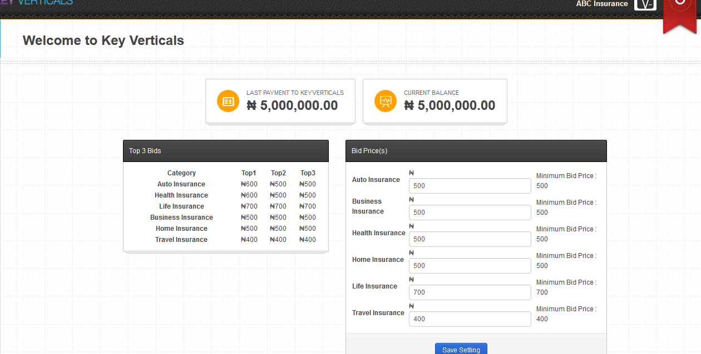
www.KeyVerticals.com
The Icing on the cake is: You Decide What You Pay, and How…
BIDDING
We show you the top 3 Bids in the Network for your active categories thereby helping you understand where you stand and your level of relative competitiveness.
REPORTING
Real-time reporting presented in a user-friendly interface lets you understand the return on your market investment.
FRAUD PROTECTION
Our system actually filters against bad contact information, bots, and the like. Sorry Mr. blabla at 123 asdfg street, with asd@aol.com email, but you’re out.
And we won’t even lock you into a long-term contract! How about that for Control...

Slide 14
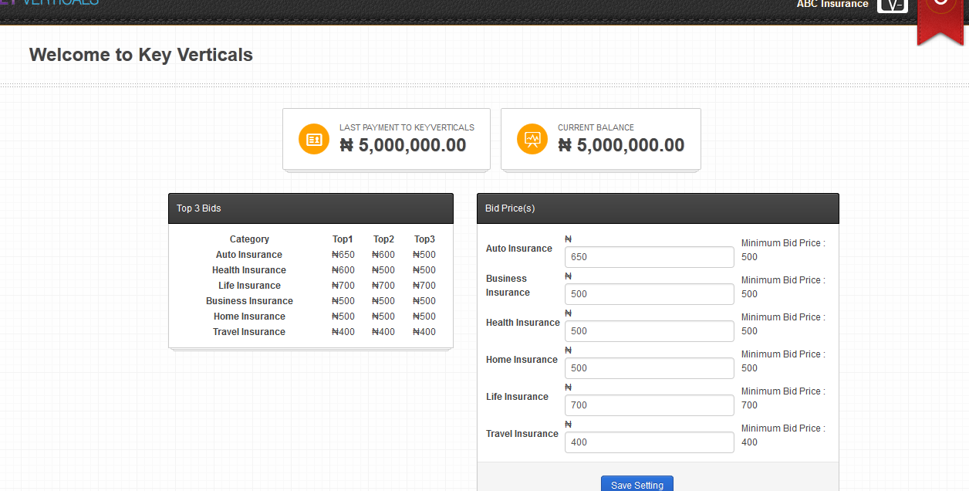
www.KeyVerticals.com
Yes, What You Pay For Each Lead is Totally up to You..

Slide 15
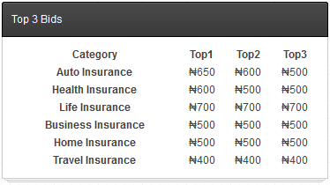
www.KeyVerticals.com
See Below:
Top 3 Bids for Each Category Your Company is Interested in getting leads. (Only the categories you selected and are approved for during registration will be shown here)
This Helps You See Your Competitiveness in any Niche at any Point in Time. Why is this important? The Next Two Slides Will be revealing & Totally Exciting or Surprising (or Both)

Slide 16
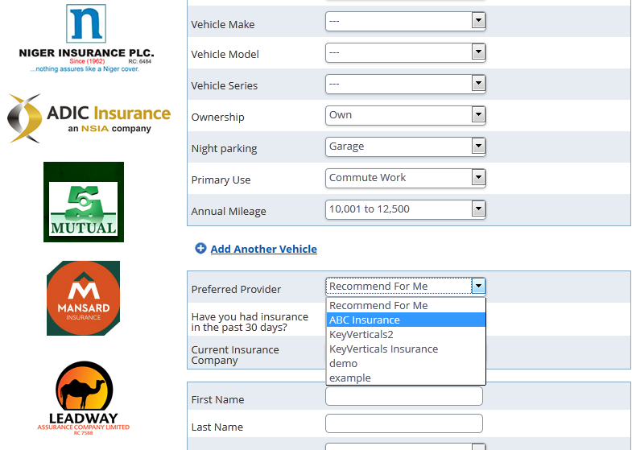
www.KeyVerticals.com
A Little More on the Bidding System...

Slide 17
www.KeyVerticals.com
A Little More on the Bidding System...
The ‘Preferred Provider’ Listings are arranged according to the Bids. So the highest Bidder comes first (Below The “Recommend For Me” field), the second highest bidder second etc...
At the Top though is the “Recommend For Me” Feature...
For all those Customers who have not already made up their minds on their preferred provider, a “Recommend for me” option will be chosen and all the leads will be Sent to the Single Highest Bidder for that Category.
It will be quite unfortunate to be found missing from this list as the Prestige associated with the Platform will convince the Customer you’re not a Major Player. And She/he will choose from Available Options. Every. Single. Time.
Makes Sense?... Lets move on.

Slide 18
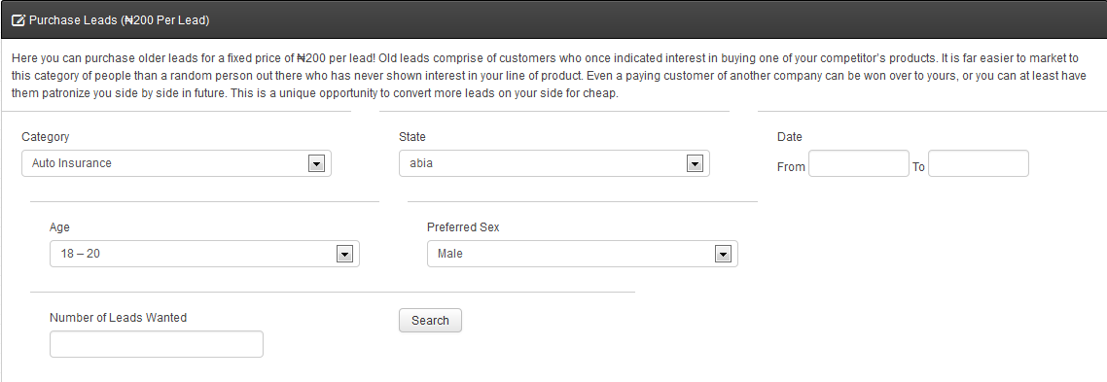
www.KeyVerticals.com
The Following Stealth Features are what makes this platform a class act:
Purchasing CUSTOM LEADS: Both From within Dashboard & Via Premium inventory on thank you page of lead form (More Info Shortly)
TAILORED SERVICES: We only make money if you do. That’s why we take a grander approach to your marketing plan. We’ll make specific recommendations to generate the best results, in the shortest amount of time. So whether you need SEO, SEM, CPR, or AAA, we’ve got you covered (okay, maybe not the last two).

Slide 19
And Even More:
www.KeyVerticals.com
INSTANT REFUND PROCESSING: If at any point in time, you feel you want to withdraw your funds, we will process it immediately and have it sent to your Preferred destination.
QUALITY ASSURANCE: Every Publisher on our Platform goes through a very thorough vetting process. If any Fraudulent Activity is detected, they loose all earnings along with their account forever. And you get credit refund for all those leads you suspected of fraud.
Awesome!!!

Slide 20
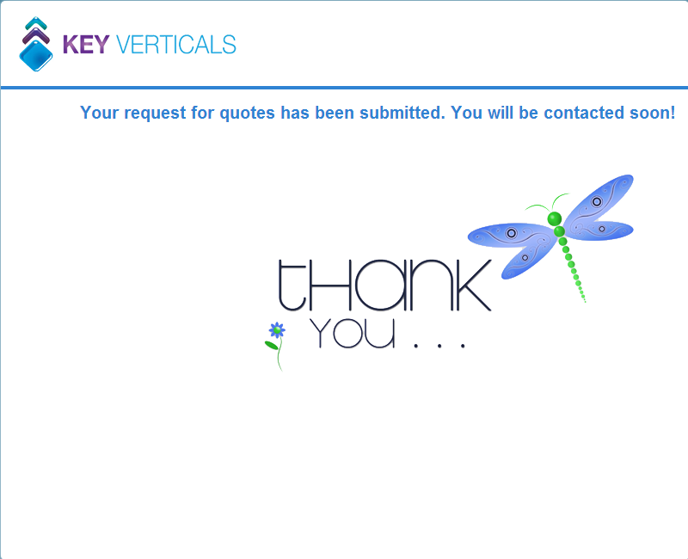
Plus A Lot More...
www.KeyVerticals.com
Branding & cross Selling Opportunities on Thank You Page.

Slide 21
www.KeyVerticals.com
Thank u page... Branding & Cross Selling Opportunities!
Once a Lead Form is Submitted, a Thank You Page comes up. This is the most targeted piece of Real Estate and the most strategic Integrated Marketing Tactic any Organization can employ for Cross Marketing, Upselling, Branding, Engaging etc.
Space on this Lead form is available on a Bid First come first served Basis. Contact your Account Manager or assigned Account Consultant for more information on Setting you up here.

Slide 22
In a Nutshell...
www.KeyVerticals.com
Key Verticals Is a Platform for Established Companies in Strong Verticals who are Dissatisfied with the Current State of Lead Generation in the Traditional and Digital Space.
Key Verticals is a new Innovation in Africa’s Digital Space that Provides Targeted Leads matching the Ideal Profile of your Customer, at a price you set. You Pay Only When a Verified Authentically Generated Lead is sent to you.
How Many Customers Can You Handle?
We’re up for the challenge – are you?

Slide 23
www.KeyVerticals.com
Conditions...
As much as we would love to do Business with everybody, we will not be able to if you break/are not up to any of our rules & standards:
You Must have an in-house Marketing Team whose job it is to call/meet up and process sales for you.
You must proactively manage customer Reviews of your Products online. If reports get to us of substandard Services, we will take you off the Platform.
You must have an Account Executive refresh your Account dashboard for hot Leads on a frequent basis (hourly preferable).
Fair Enough?

Slide 24
www.KeyVerticals.com
Lets Be Partners...
The Following Awaits You FREE:
A Dedicated Account Rep (Value N300k/month).
Complete Phone, email and chat support 24/7. (Value N100k/Month)
Set-Up Fee Waiver. (Value N80,000)
Strategic Consultations for Optimized Usage of Platform & Competitive Edge. (Value Priceless)
Lets Lock Arms & Redefine Digital Performance Advertising Once & For All...

Slide 25
www.KeyVerticals.com
We’ve Given Quite a Lot...
Do you deserve to possess the Competitive Edge?
Do you have Vision and can see where this is going?
Then Lets get started...
Account Reps will be assigned to you immediately to begin to help you create accounts right away...

Slide 26
www.KeyVerticals.com
What to do Next!
Meet Our Already Waiting Account Reps. They Will help you get set up.
Issue a check in the format provided to you by the KeyVerticals team.
Your Funds Will be Uploaded Straight Away into the Platform for your Convenience as soon as payment is confirmed.
They will then help you set up on the system.
Account Reps will be assigned to you immediately to begin to help you create accounts right away...
Please proceed to http://www.keyverticals.com/sign_up to get started!

Slide 27
See You On the Other Side
Where Leads are Hot, Marketing is precise, Results are assured & Revenue Targets are Met!
Life’s Good – Live It!

Slide 28
www.KeyVerticals.com
Thank You For Your Time
Questions
The Penthouse, Theodolite House, 306 Ikorodu Road, Anthony, Lagos
www.KeyVerticals.com
Facebook.com/KeyVerticals
01-4540940
(234)7089996189
(234)8080369352
admin@KeyVerticals .com
@KeyVerticals

